Slide 1
Travel Touch: A Comprehensive Tourist Management System
Course Name: Information System
Analysis and Design
Course Code: CSE347
Section: 05

Slide 2
SUBMITTED BY:
SUBMITTED TO:
Name | Student ID
Hemary Ahmed | 2022-3-60-008
Mujahida Nazmoon Naher | 2022-2-60-099
Tasnia Tabassum Azra | 2022-3-60-084
Md. Danish Ahmed | 2020-2-60-085
MD Sabbir Hossain
Lecturer
Department of
Computer Science and
Engineering
East West University

Slide 3
1. INTRODUCTION

Slide 4
TravelTouch is a simple and smart platform that connects admins, travel agents, and tourists. It helps everyone manage trips easily, keeps records organized, and ensures all bookings are safe and trustworthy. Each type of user has its own set of tools and features.
Admins oversee the system, approve new listings, and make sure everything is safe and reliable. Example: Admin checks if a hotel added by an agent actually exists and meets quality standards.
Agents manage tourist spots, upload new destinations, track bookings, and handle packages in one place. Example: An agent uploads pictures of a new beach resort, adds hotel and flight details, and sets package prices.
Tourists explore verified destinations, book trips, and give ratings or reviews to help other travelers. Example: A tourist books a 3-day trip to Cox’s Bazar and leaves a 5-star review for the hotel.
TravelTouch uses secure login, verified listings, and multiple payment options to make everything safe and convenient.

Slide 5
2. USE CASE DIAGRAM

Slide 6
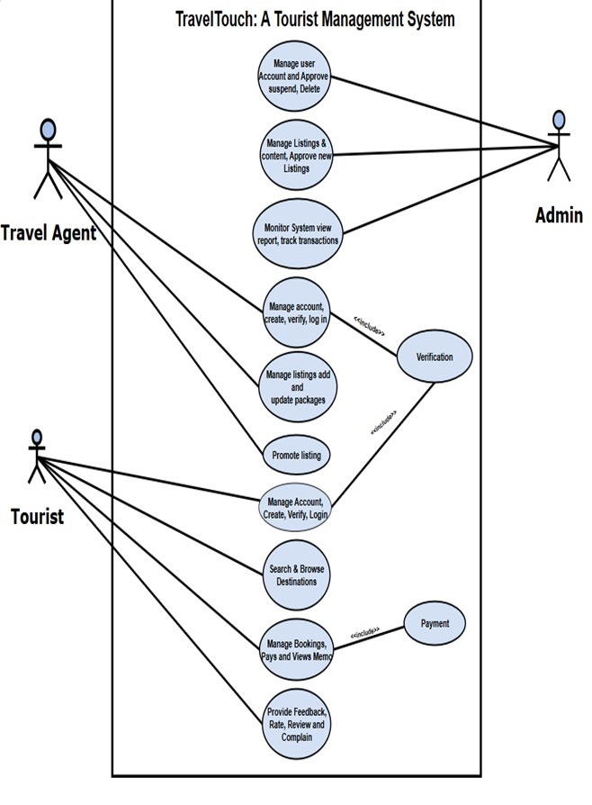
The diagram shows how Admins, Travel Agents, and Tourists interact with the system:
🛠️ Admin
Manages user accounts (approve, suspend, delete)
Approves and manages listings/content
Monitors the system and tracks transactions.
🧳Travel Agent
Creates and manages their account
Adds and updates travel packages
Promotes listings
✈️ Tourist
Creates and manages their account
Searches and browses destinations
Books trips, makes payments, and views booking memos, gives feedback, ratings, and reviews.
⚙️ Additional Features
Verification: Included in account management to ensure security
Payment: Included in booking management for safe transactions

Slide 8
3. CLASS DIAGRAM

Slide 9
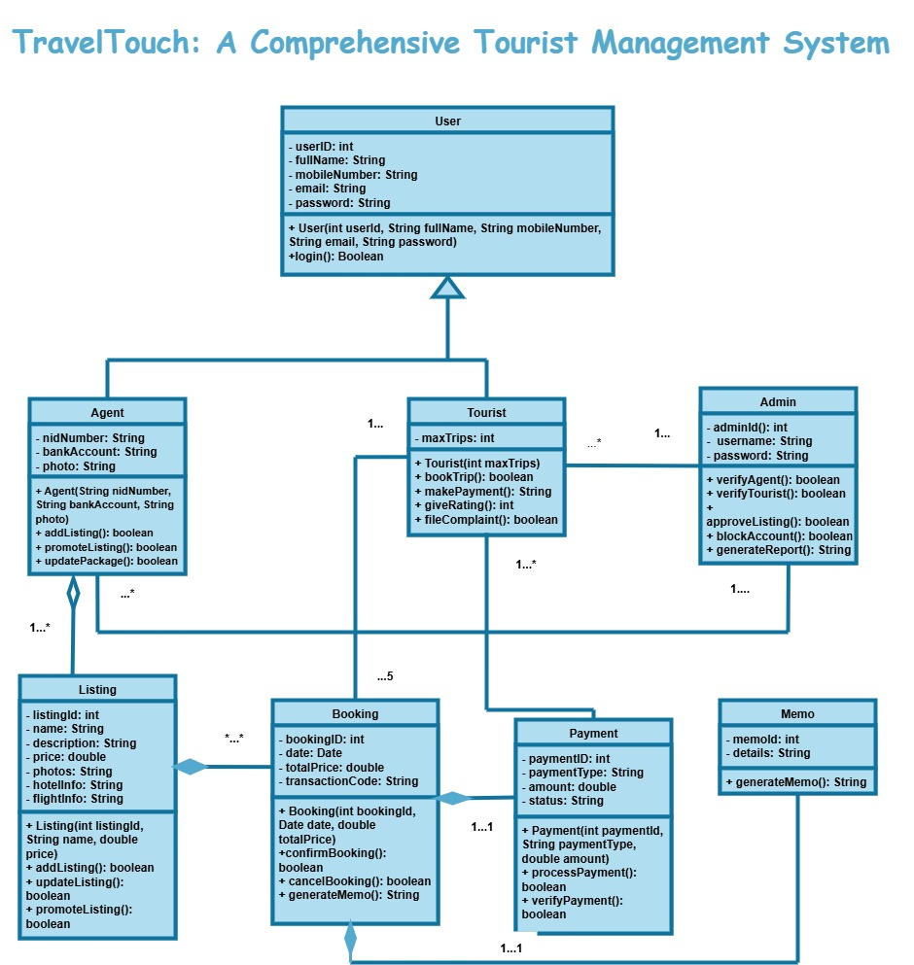
This class diagram represents a Tourist Management System. It uses OOP concepts like: Classes, Attributes, Methods, Inheritance, Associations, Aggregations, Compositions.
There are total 8 classes. In this diagram the parent class is: User class and child classes are: Agent, Tourist.
All classes are given below:
User
Agent
Tourist
Admin
Lisitng
Booking
Payment
Memo

Slide 10
RELATIONSHIPS:
Inheritance: User → Agent, Tourist.
Association:
Tourist ↔ Booking
Tourist ↔ Payment
Admin ↔ Agent
Admin ↔ Tourist
Aggregation (◇):
Agent ↔ Listing
Composition (◆):
Booking ↔ Memo
Booking ↔ Payment
Booking ↔ Memo

Slide 12
4. DEPLOYMENT DIAGRAM

Slide 13
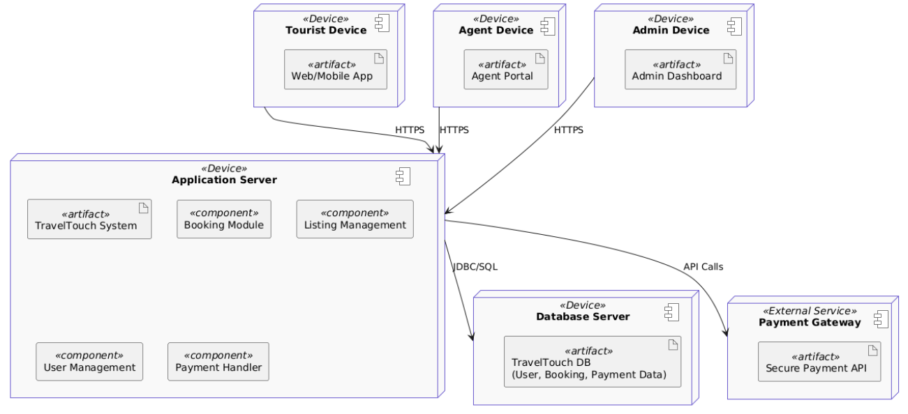
Tourist Device
Runs Web/Mobile App
Connects to Application Server via HTTPS
Agent Device
Runs Agent Portal
Connects via HTTPS
Admin Device
Runs Admin Dashboard
Connects via HTTPS
Application Server
Hosts TravelTouch System
Contains main components:
Booking Module
Listing Management
User Management
Payment Handler
Database Server
Stores TravelTouch DB (User, Booking, Payment Data)
Connected to Application Server via JDBC/SQL
Payment Gateway (External Service)
Provides Secure Payment API
Communicates with Application Server via API Calls

Slide 15
5. ER DIAGRAM

Slide 16
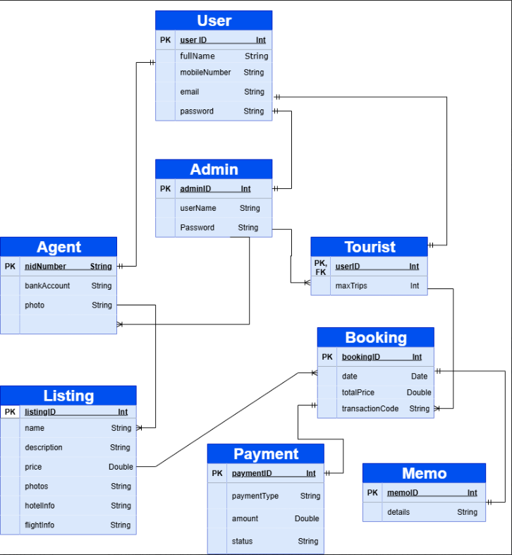
ER Diagram – Key Points
Users: Core entity for login & profiles (Tourists, Agents, Admins).
Tourists: Book trips and connect with listings.
Agents: Create listings, verified with NID & bank info.
Admins: Manage agents and oversee system operations.
Listings: Travel packages with price, hotel & flight info.
Bookings: Link tourists, listings, payments & memos.
Payments & Memos: Ensure secure transactions and booking confirmation.

Slide 18
6. SEQUENCE DIAGRAM

Slide 19
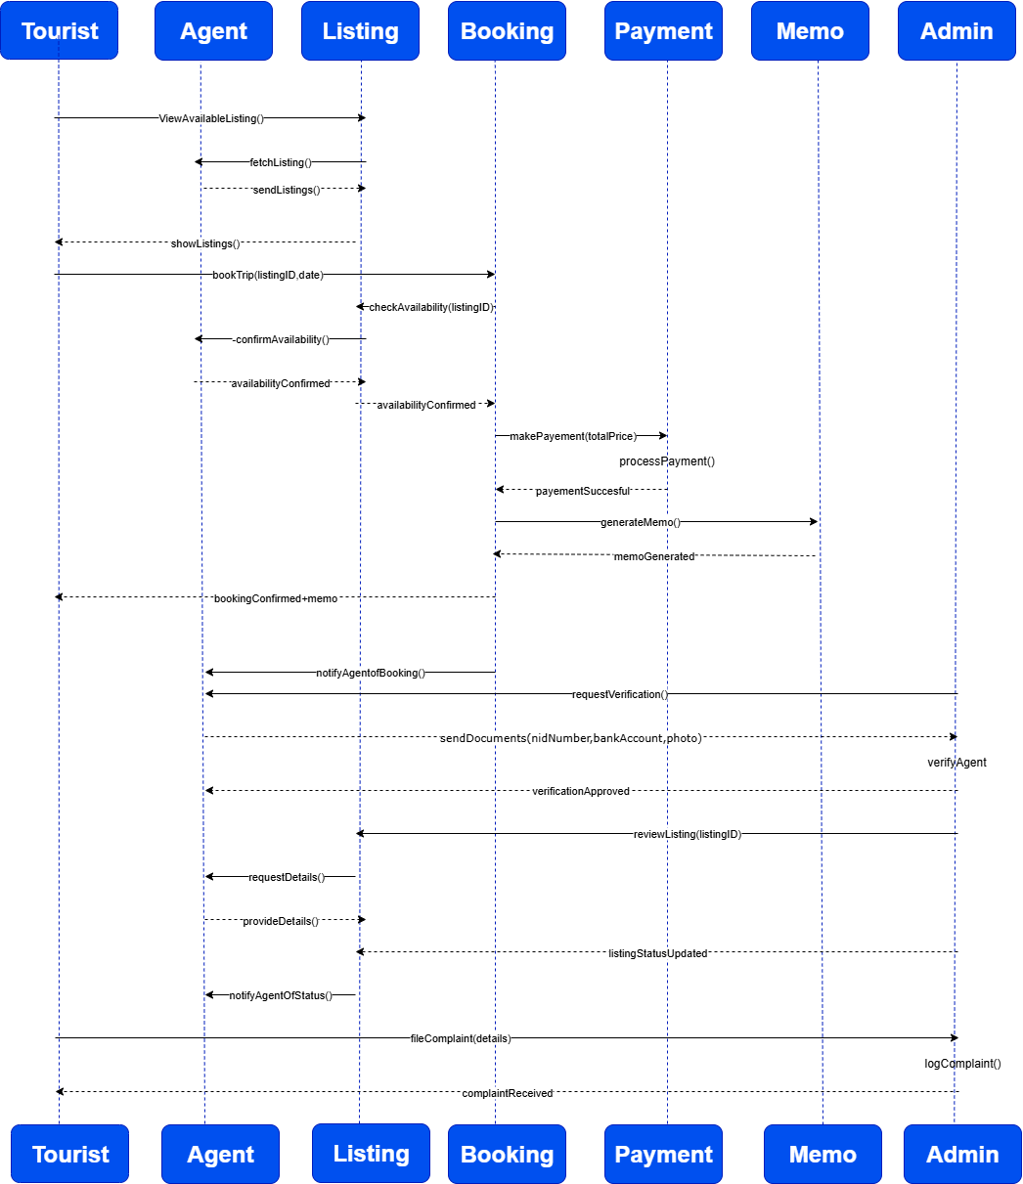
This is a sequence diagram which:
Shows interaction between Tourist, Agent, Admin, and system modules.
Flow: Tourist views listings → books trip → payment → memo generated.
Agent is notified, Admin verifies and approves listings.
Complaint handling is also included.
Represents complete workflow from trip selection to booking confirmation.

Slide 21
7. ACTIVITY DIAGRAM

Slide 22
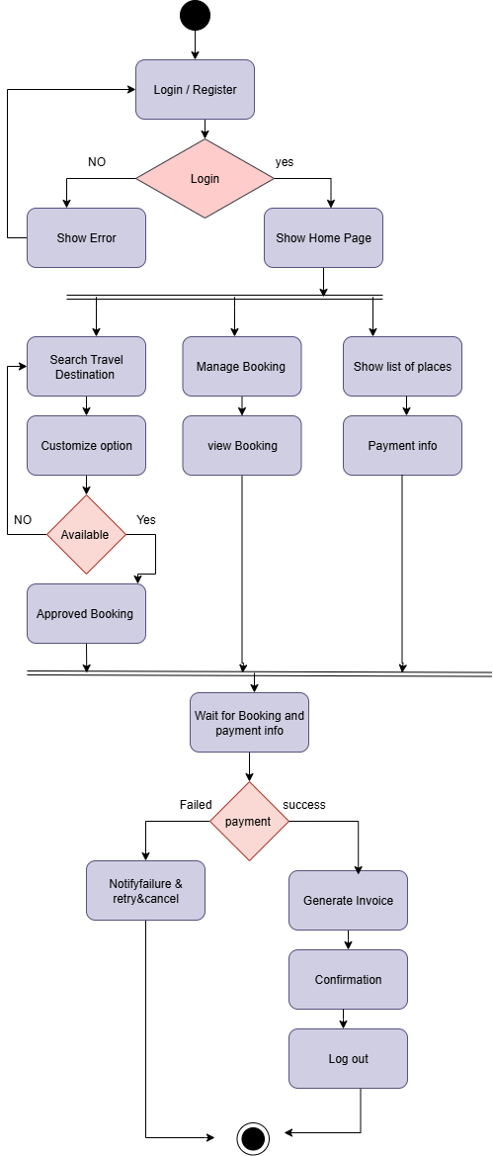
ACTIVITY DIAGRAM OF TOURIST
Tourist Action:
Login/Register – The tourist starts by creating an account or logging in.
Explore Options – They can:
Search travel destinations and customize their trip.
View/manage their bookings.
See a list of places and check payment info.
Booking – If the chosen destination is available, the booking is approved.
Payment – The tourist proceeds with payment

Slide 23
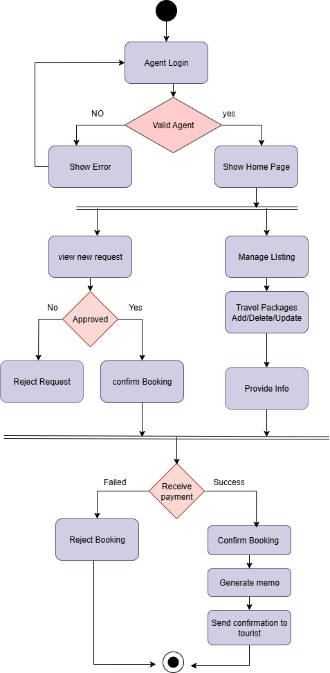
ACTIVITY DIAGRAM OF AGENT
Login – The agent logs in to the system.
Manage Requests – They can:
View new booking requests. Approve or reject requests
Add, update, or delete travel packages.
Provide information to tourists.
Booking & Payment – Once a booking is approved, payment is processed.
If payment fails → booking is rejected.
If payment succeeds → booking is confirmed,
a memo is generated, and confirmation is sent to the tourist.

Slide 24
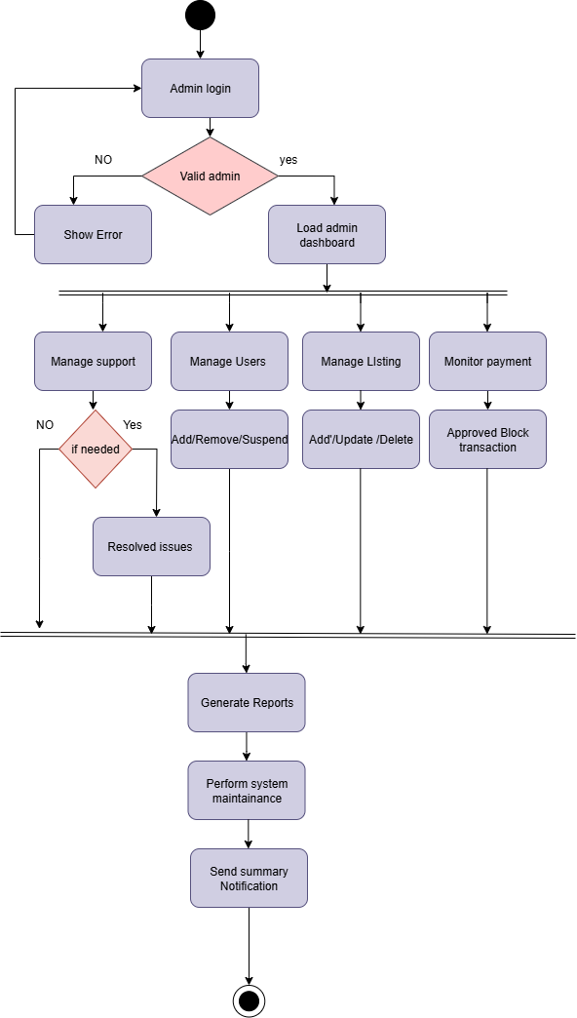
ACTIVITY DIAGRAM OF ADMIN
Admin Action:
Login – Enter the system.
Manage Users – Add, delete, or update user information.
Manage Data/Records – Insert, update, or remove data from the system.
Generate Reports – Create different kinds of reports.
Monitor System – Oversee system activities.
Logout – Exit the system.

Slide 25
8. COMPONENT DIAGRAM

Slide 26
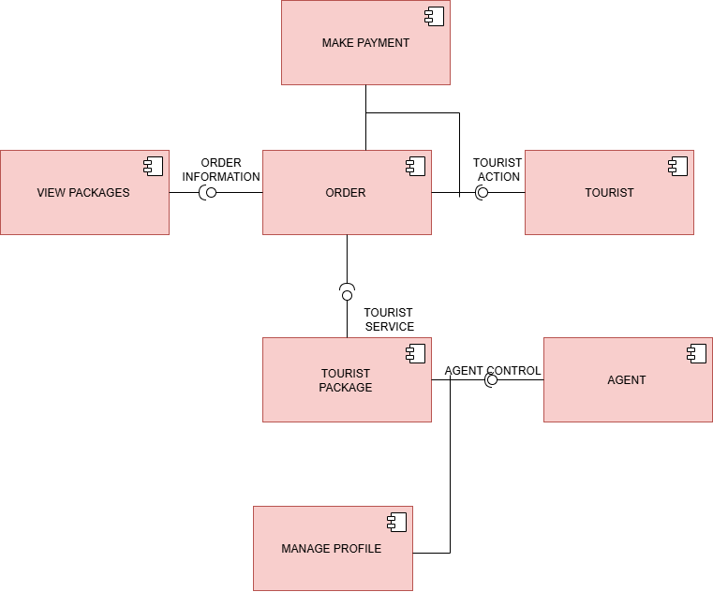
A component diagram shows the main parts of a system (modules) and how they interact, helping to understand the system’s structure at a high level.
Tourist
The main user who uses the system.
They can view packages, place orders, make payments, and manage their profile.
Agent
The service provider.
They can create, update, and manage tour packages and their own profile.
View Packages
A component that shows available tour packages to tourists.
Order
Handles bookings when a tourist decides to buy a package.
Make Payment
Manages online or offline payments for bookings.
Tourist Package
Stores all the details of different travel/tour packages.
Acts as the main database of the system.
Manage Profile
Lets both Tourists and Agents manage their personal details, preferences, and login information.

Slide 28
09. DATA FLOW DIAGRAM

Slide 30
10. CONCLUSION

Slide 31
CONCLUSION
The Tourist Management System helps bring admins, agents, and tourists together in one organized platform. It ensures safe and verified bookings, easy account management, and smooth handling of travel packages. Admins can control quality, agents can promote destinations, and tourists can book trips with confidence. Overall, it makes traveling more convenient, reliable, and enjoyable.

